Slide 1

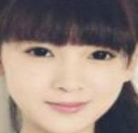
FACE RECOGNITION (With Mask or Without Mask)

Slide 2
FACE RECOGNITION OVERVIEW
Take Photo
Image with Background present
AI Brain Accepts only Face With Mask or Non Mask
Using of Preprocessing(Pretrained) crop the image
Give to our created Model
Image ready
Predict the Face
Output

Slide 3
TRAIN MASK DETECT(Coding Explain)
Preprocess the image
Data→ Input
Label→Output
Load The Image Path
Data and Label Changed to Numbers
Split Train and Test set
Head Model run with weights
Weights of Best Model
Best Model
Load the MobileNetv2
(Pretrained)
Model
(basemodel,headmodel)
Freeze the Train
Optimizer and compile Model
Fit the Model
Training and Loss Accuracy Graph Plot
Classification report
Predict of Test set

Slide 4
DETECT MASK(APPLICATION)(Coding Explain)
Detect and Predict Mask
Frame
(Photo On)
FaceNet
(Using of Blob) croped
Pretrained(caffeMOdel
Initialise (Face,Locs,Pred)
MaskNet
Our Created Model
Loop Detection(FaceNet)
Convert to numpy & preprocess
Extract the face
Convert to RGB
Predicts face of locs
Load face Detector Model
Determine Face mask or not mask
Output Video
Video stream

Slide 5
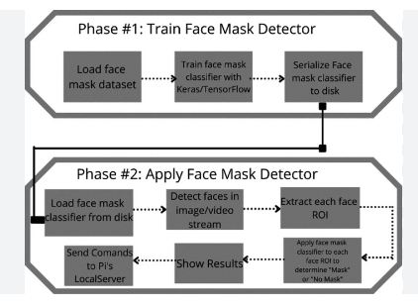
Overall Coding Simple Process

